Slide 1

Adaptive techniques for approximating solutions to 1st-order initial-value problems

Slide 2
Introduction
In this topic, we will
  Describe adaptive algorithms for initial-value problem (ivp) solvers
  List the algorithms we will see in this topic
  Discuss making dynamic changes to the step size
    This will include limitations
  Discuss appropriate data structures for such algorithms

Slide 3
Iterative methods
In order to estimate the error, previously
we had to approximate the solution with n points,
and then again with 2n points
  Our error analysis suggested the error should drop by h, h² or h⁴, depending on the algorithm
This potentially requires us to do a significant amount of work!

Slide 4
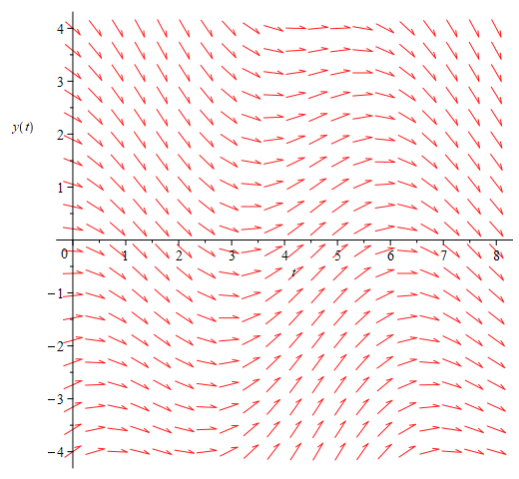
Adaptive techniques
Instead, we will use the following approach:
  At each step,
  we will try to estimate the error of the next approximation

Slide 5
Adaptive techniques
Thus, we proceed as follows:
  Given an approximation y_{k} at a point t_{k},
    Use two algorithms, one significantly more precise (z_{k+1}) than the other (y_{k+1})

Slide 6
Adaptive techniques
Neither z_{k+1} nor y_{k+1} is exact, but because z_{k+1} is much more accurate, then |z_{k+1} – y_{k+1}| is a not-unreasonable approximation of the error of y_{k+1}
  Like before, to be conservative, we’ll over-estimate the error:
  2|z_{k+1} – y_{k+1}|

Slide 7
Adaptive techniques
Because ε_{abs} is the maximum error we are allowed to accept per unit time, the maximum error we are willing to accept is ε_{abs}h
  If 2|z_{k+1} – y_{k+1}| < ε_{abs}h, we’re okay
  Otherwise, we need to try again with a smaller h…

Slide 8
Adaptive techniques
Thus, we have two possibilities:
  If 2|z_{k+1} – y_{k+1}| < ε_{abs}h, our approximation is too accurate
    We could use a larger value of h with the next step
  If 2|z_{k+1} – y_{k+1}| ≥ ε_{abs}h, the error is too large
    We need to try again with a smaller value of h

Slide 9
Adaptive techniques
Questions:
  In the first case, how much larger can we make h?
  In the second case, how much smaller must we make h?
Answers:
  We will calculate a scaling factor a
    If a > 1, then h can be made larger, so continue
    If a ≤ 1, then h is too large, so try again
Question:
  Isn’t ah the “ideal” step size?
Answer:
  It approximates the ideal step size for the current point
  Issue: The chance is 50-50 that the next ideal step size smaller
  Solution: Multiply a by 0.9

Slide 10
Looking ahead
We will look at two adaptive algorithms:
  In order to introduce this concept,
  we will look at using both Euler and Heun
  The second algorithm is the Dormand-Prince algorithm

Slide 11
Warnings
We will determine better values of h,
however, these algorithms will require:
  A minimum value of h_{min} to use
  A maximum value of h_{max} based on the problem at hand
    If h is too large, we may lose detail in the differential equation
  An initial value of h to use
    We will use , the geometric mean
Also, while we’d like to get h to the ideal width,
we will be using approximations to change the size of h
  Again, being conservative:
    We will never let h be more than doubled with any step
    We will never let h be less than halved in any step

Slide 12
Data structures?
What data structures will we use for these algorithms?
  Problem: We don’t know how many steps we will require
  If we allocate an array, it may occur that:
    The array is far too large, so we have wasted memory
    The array is too small, and we must allocate a larger array and copy everything over…
      Doubling the array capacity may result in O(n) wasted memory
  Instead, the algorithm will use a data structure that:
    Allows O(1) insertions with all operations
    Has O(1) wasted memory
    That is, a queue!
  At the end, we will convert it back to an array

Slide 13
Implementation
std::tuple<unsigned int, double *, double *, double *> adaptive_algorithm(
double f( double t, double y ), std::pair<double, double> t_rng, double y0,
std::pair<double, double> h_rng, double eps_abs
) {
assert( h_rng.first > 0.0 );
assert( h_rng.second > h_rng.first );
double h{ std::sqrt( h_rng.first *h_rng.second ) };
std::queue<double> qt{};
std::queue<double> qy{};
std::queue<double> qdy{};
qt.push( t_rng.first );
qy.push( y0 );
qdy.push( f( t_rng.first, y0 ) );

Slide 14
Implementation
while ( qt.back() < t_rng.second ) {
bool found{ false };
do {
double y{ /* First approximation */ };
double z{ /* Second (better) approximation */ };
double a{ /* Calculate scaling factor for 'h' */ };
if ( (a > 1.0) || (h == h_rng.first) ) {
qt.push( qt.back() + h );
qy.push( z );
qdy.push( f( qt.back(), z ) );
found = true;
}
} while ( !found );

Slide 15
Implementation
a *= 0.9;
if ( a >= 2.0 ) {
h *= 2.0;
} else if ( a <= 0.5 ) {
h *= 0.5;
} else {
h *= a;
}
if ( h < h_rng.first ) {
h = h_rng.first;
} else if ( h > h_rng.second ) {
h = h_rng.second;
}
} while ( !found );
}

Slide 16
Implementation
unsigned int n{ static_cast<unsigned int>( qt.size() ) };
double *ts = new double[n];
double *ys = new double[n];
double *dys = new double[n];
for ( unsigned int k{0}; k < n; ++k ) {
ts[k] = qt.front();
qt.pop();
ys[k] = qy.front();
qy.pop();
dys[k] = qdy.front();
qdy.pop();
}
return std::make_tuple( n - 1, ts, ys, dys );
}

Slide 17
Summary
Following this topic, you now
  Understand what an adaptive ivp solver is
  Know we will use two different approximations
    The better approximation allows us to estimate the error
    of the worse approximation
  Are aware we will introduce an Euler-Heun adaptive algorithm,
  and then we will describe the Dormand-Prince method
  Understand that this will allow us to dynamically change the value of h
  Understand there are restrictions to both the magnitude of h and restrictions to any changes to h
  Are aware of data structure issues in implementations

Slide 18
References
[1] https://en.wikipedia.org/wiki/Adaptive_algorithm
[2] https://en.wikipedia.org/wiki/Adaptive_step_size

Slide 19
Acknowledgments
None so far.

Slide 20



Colophon
These slides were prepared using the Cambria typeface. Mathematical equations use Times New Roman, and source code is presented using Consolas. Mathematical equations are prepared in MathType by Design Science, Inc.
Examples may be formulated and checked using Maple by Maplesoft, Inc.
The photographs of flowers and a monarch butter appearing on the title slide and accenting the top of each other slide were taken at the Royal Botanical Gardens in October of 2017 by Douglas Wilhelm Harder. Please see
https://www.rbg.ca/
for more information.

Slide 21
Disclaimer
These slides are provided for the ece 204 Numerical methods course taught at the University of Waterloo. The material in it reflects the author’s best judgment in light of the information available to them at the time of preparation. Any reliance on these course slides by any party for any other purpose are the responsibility of such parties. The authors accept no responsibility for damages, if any, suffered by any party as a result of decisions made or actions based on these course slides for any other purpose than that for which it was intended.

